Slide 1
Chapter 2 Architecture of Embedded Systems

Slide 2
Overview of Embedded System Architecture
Every embedded system consists of custom-built hardware built around a Central Processing Unit (CPU).
The software residing on the memory chip is also called the ‘firmware’.

Slide 3
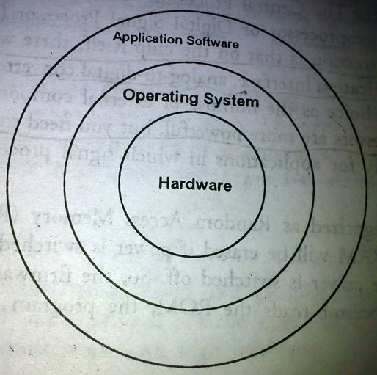
The operating system runs above the hardware, the application software runs above the operating system.
To have operating system in Embedded System is not compulsory. For example in case of small appliances such as remote control units, air-conditioners, toy etc there is no need of operating system
It is possible to write small software specific to that application.

Slide 4
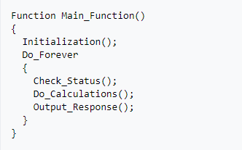
Pseudocode

Slide 5
For the complex processing, it is better to have operating system, in which deployment of application in the memory chips after operating system is integrated with the application.
Once the software is transferred to the memory chip, the software will continue to run for a long time and don't need to reload new software.

Slide 6
CA
Refer Moodle (1)

Slide 7
Various building blocks of the hardware of an embedded system.
Central Processing Unit (CPU)
Memory (Read-only Memory and Random Access Memory)
Input Devices
Output Devices
Communication Interfaces
Application-specific circuitry

Slide 8
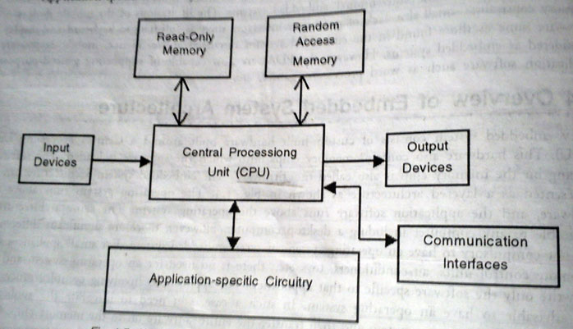
Simplified Hardware Architecture of an Embedded System

Slide 9
Central Processing Unit (CPU)
The Central Processing Unit (Processor) can be any of the following:
Micro-controller,
Microprocessor
Digital Signal Processor (DSP)
For small applications microcontroller is the best choice as the number of external components required very less.
Microprocessor is very powerful, but it needs many external components
DSP is used mainly for applications for signal processing is involved such as audio and video processing.

Slide 10
Memory
Memory are categorized as
Random Access Memory (RAM)
Read Only Memory (ROM)
The contents of the RAM will be erased if power is switched off to the chip, whereas ROM retains the contents even if the power is switched off. So, the firmware is stored in the ROM.
When power is switched on, the processor read the ROM, the program is transferred to RAM and the program is executed.

Slide 11
Input Devices
Unlike the desktops, the input devices to an embedded system have very limited capability. There will be no keyword or a mouse and hence interacting with the embedded system is no easy task.
Many will have small keypad.
They take inputs from sensors or transducers and produce electrical signals that are in turn fed to others systems.

Slide 12
Output devices
Mostly output of embedded system is also limited capability.
Some embedded systems will have a few Light Emitting Diodes (LEDs).
A small Liquid Crystal Display (LCD)

Slide 13
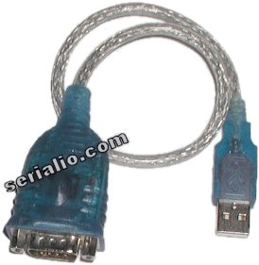
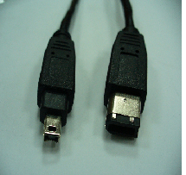
Communication Interfaces
The embedded systems may need to interact with other embedded systems.
Very few communication interfaces such as RS232, RS422, RS485, Universal Serial Bus (USB), IEEE 1394, Ethernet etc

Slide 14
Application-specific Circuitry
Sensors, transducers, special processing and control circuitry may be required for an embedded system, depending on its application. This circuitry interacts with the processor to carry out the necessary work.
The entire hardware has to be given power supply either through the 220 volts main supply or through a battery.
The hardware has to be designed in such a way that the power consumption is minimized.
Sensors are devices which mainly sense any thing and give output in any desired form; where as transducers are devices that transform one form of energy in to another form.
transducer is a device which converts one form of signal to another. For example, an LED is a transducer which converts electrical energy to light, or an antenna converts EM wave energy to electrical signal.

Slide 15
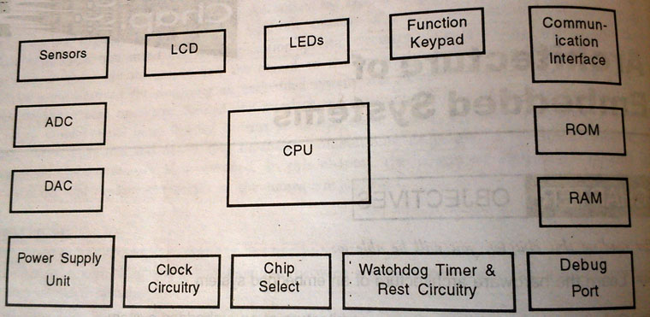
Hardware Architecture
Building Blocks of the Hardware in an Embedded System

Slide 16
Central Processing Unit
The central Processing Unit (CPU) used in an embedded system can be one of the following two categories:
General Purpose Processor (GPP)
Digital Signal Processor (DSP)

Slide 17
In case of General Purpose Processor (GPP) are further classified as micro-controllers and microprocessors.
Micro Controller has a memory and other peripheral on the chip itself; hence it is the best choice for small embedded Systems.
Microprocessor is more powerful but requires a large number of external components.

Slide 18
Microcontroller
A single chip that contains the processor (the CPU), non-volatile memory for the program (ROM or flash), volatile memory for input and output (RAM), a clock and an I/O control unit.
Also called a "computer on a chip," billions of microcontroller units (MCUs) are embedded each year in a myriad of products from toys to appliances to automobiles. For example, a single vehicle can use 70 or more microcontrollers.

Slide 19
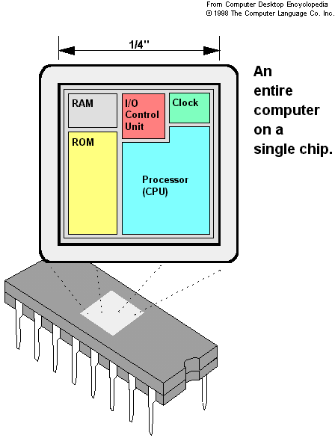

Slide 20
Microprocessor | Microcontroller
A silicon chip representing a central processing unit(CPU), which is capable of performing arithmetic as well as logical operations according to a pre-defined set of instructions | A microcontroller is a highly integrated chip that contains a CPU, RAM, special and general purpose register arrays, on chip ROM/ FLASH memory for program storage, timer and interrupt control units and dedicated I/O ports.
It is a dependent unit. It requires the combination of other chips like timers, program and data memory chips; interrupt controllers, etc. for functioning. | It is a self-contained unit and it doesn’t require external interrupt controller, timer, UART, etc for its functioning.
Most of the time general purpose in design and operation. | Mostly application-oriented or domain-specific.
Limited power saving options compared to micro-controllers | Includes lot of power saving features

Slide 21
Links
https://www.engineersgarage.com/tutorials/difference-between-microprocessor-and-microcontroller/

Slide 22
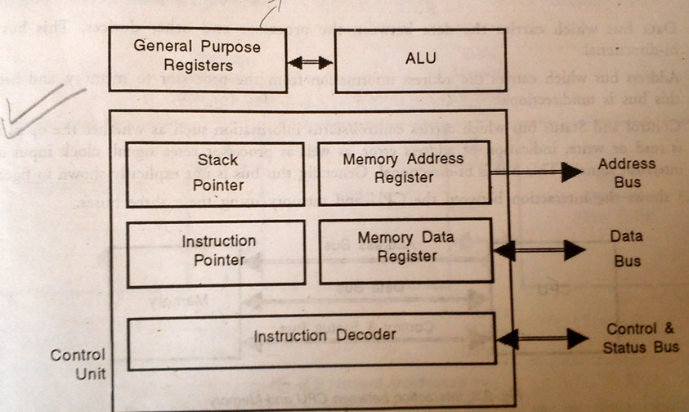
Internal Architecture of a Processor

Slide 23
Processor Architectures
The CPU consists of
Arithmetic Logic Unit (ALU) which performs arithmetic and Logic operations (such as add, multiply, subtract etc )
General Purpose Registers. These Registers constitute the processor’s internal memory. The number of registers varies from processor to processor. Registers contain the current data and operands that are being manipulated by the processor.
Control unit that fetches the instructions from memory, decodes them and executes them.

Slide 24
Register
Instruction Decoder
Its purpose is to translate an instruction code into the address in the micro memory where the micro code for the instruction starts.

Slide 25
Register
Stack Pointer
It stores the address of the last program request in a stack.

Slide 26
Register
Instruction pointer
It holds the address of the next instruction to be executed. Control flow instructions such as jumps, conditional branches, subroutine calls and returns manipulate the instruction pointer.[PC(Program Counter), IAR(Instruction Address Register)]

Slide 27
Register
Memory Address Register(MAR)
It is the CPU register that either stores the memory address from which data will be fetched to the CPU, or the address to which data will be sent and stored.

Slide 28
Register
Memory Buffer Register(MBR,MDR)
It is the register in a computer's processor, or central processing unit, CPU, that stores the data being transferred to and from the immediate access storage.

Slide 29
Processor Architectures
To manipulate data, processor’s job is
to read data and instructions from memory,
read and write data to memory,
write data to output devices, and
read data from input devices.
To do these functions, the processor communicates with other devices using three buses, a bus being a group of signals. These buses are:
Data bus
Address bus
Control and Status bus

Slide 30
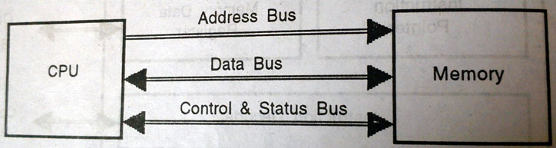
Data bus which carries the data between the processor and other devices. This bus is bi-directional.
Address bus which carries the address information from the processor to memory, and hence this bus is unidirectional.

Slide 31
Control and Status bus which carries control/status information such as whether the operation is read or write, indication of address error, as well as processor reset signal, clock input and interrupt signals.
This bus is bi-directional.

Slide 32
Based on the number of memory and data buses used, there are three types of architectures for the processors. These are
Von Neumann Architecture
Harvard Architecture
Super Harvard Architecture

Slide 33
Von Neumann Architecture
Microprocessors/controllers based on the Von-Neumann architecture shares a single common bus for fetching both instructions and data
Von-Neumann architecture based processors/controllers first fetch an instruction and then fetch the data to support the instruction from code memory.
The two separate fetches slows down the controller’s operation.

Slide 34
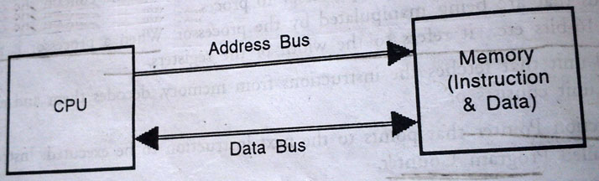

Slide 35
Harvard Architecture
Harvard architecture will have separate data bus and instruction bus.
This allows the data transfer and program fetching to occur simultaneously on both buses.
In this model, the data memory can be read and written while the program memory is being accessed.
These separated data memory and code memory buses allow one instruction to execute while the next instruction is fetched (“pre-fetching”).
The pre-fetch theoretically allows much faster execution than Von-Neumann architecture

Slide 36
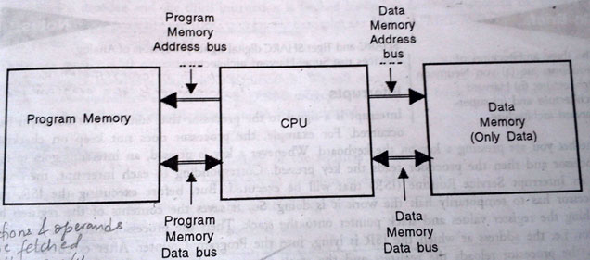

Slide 37
In this architecture, there are two separate memory blocks- one is program memory and the other is data memory. Program memory stores only instructions and data memory stores only data. Two pairs of data buses are used between the CPU and the memory blocks.

Slide 38
Von-Neumann Architecture | Harvard Architecture
Single shared bus for instruction and data fetching | Separate buses for instruction and data fetching
Low performance compared to Harvard architecture | Easier to pipeline, so high performance can be achieved
Cheaper | Comparatively high cost
Allows self modifying codes | No Memory alignment problems
Since data memory and program memory are stored physically in the same chip, chances for accidental corruption of program memory. | Since data memory and program memory are stored physically in different locations, no chances for accidental corruption of program memory
Note: Self-modifying code is code that alters its own instructions while it is executing
- usually to reduce the instruction path length and improve performance or simply
to reduce otherwise repetitively similar code, thus simplifying maintenance.
Atmel's AVRs have a single level pipeline design.
This means the next machine instruction is fetched as the current
one is executing.

Slide 39
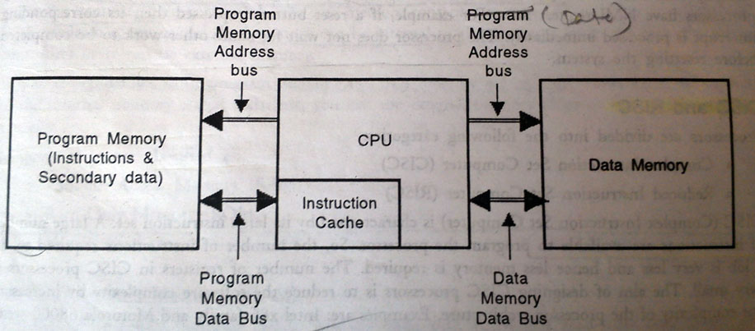
Super Harvard Architecture
A slight but significant modification of the Harvard architecture.
In Harvard architecture, the data memory is accessed more frequently than the program memory.
So SHARC is design to store some secondary data in the program memory to balance the load on both memory blocks. This architecture is used in Digital Signal Processor.

